Slide 1


INSTITUTE FOR ADVANCED COMPUTING AND SOFTWARE DEVELOPMENT, AKURDI, PUNE pg Dac march 2023
A presentation on CAREHUB (hospital facility app)
Submitted by
Project Guide Project By-
Mrs Gee ta Darunte Swapnil Kumar Srivastava (233103)
Shivam Bhosale (233088)

Slide 2
CAREHUB A complete solution for Hospital Services and Activity

Slide 3
carehub
Description
The project CAREHUB is a Hospital Management system(HMS) which includes registration of patients, storing their details into the system, giving fast medical facilities by scheduling appointments with doctors and also computerized billing in the pharmacy, and labs. The software has the facility to give a unique id for every patient and stores the details of every patient and the staff automatically.

Slide 4
carehub
Features of CAREHUB
Medical Inventory Management.
Patient Scheduling.
Human Resources.
Analytics and Reporting.
Billing and Management.

Slide 5
carehub
This Software targets to provide complete solution for Hospital and related services. The software Includes following Roles:
Admin
Receptionist
Add Patient
Add Doctor
Ward Incharge

Slide 6
CareHUB
Lab Incharge
Pharmacist

Slide 7
CAREHUB
Technologies Used
Backend :- J2EE, SpringBoot, MySQL, Hibernate
Frontend :- HTML, CSS, React Js
Frontend & Backend connection with the help of Axios through REST API

Slide 8
carehub
Database Design
Created database according to E-R diagram
Inserted data with the help of SQL queries
Problem :-
everytime required to SQL queries to fill the data into database
Solution :-
So we used Hibernate to insert data directly into database

Slide 9
Carehub
BACKEND
DTOS(data transfer/ transaction object): - storing the data from frontend and store in the database
Service :- service layer used repository(DAO/DTOS) to perform the CRUD operation i.e the business logic.
Controller :- controller accept request from user go to the service layer and work on the request which is sent by user.

Slide 10
Carehub
FRONTEND
Header :- Created Navbar using React.js which is common for all pages.
Homepage :- having Sign In with username & password.
Pages :- Admin Panel, Doctor Panel, Pharmacist Panel.

Slide 11
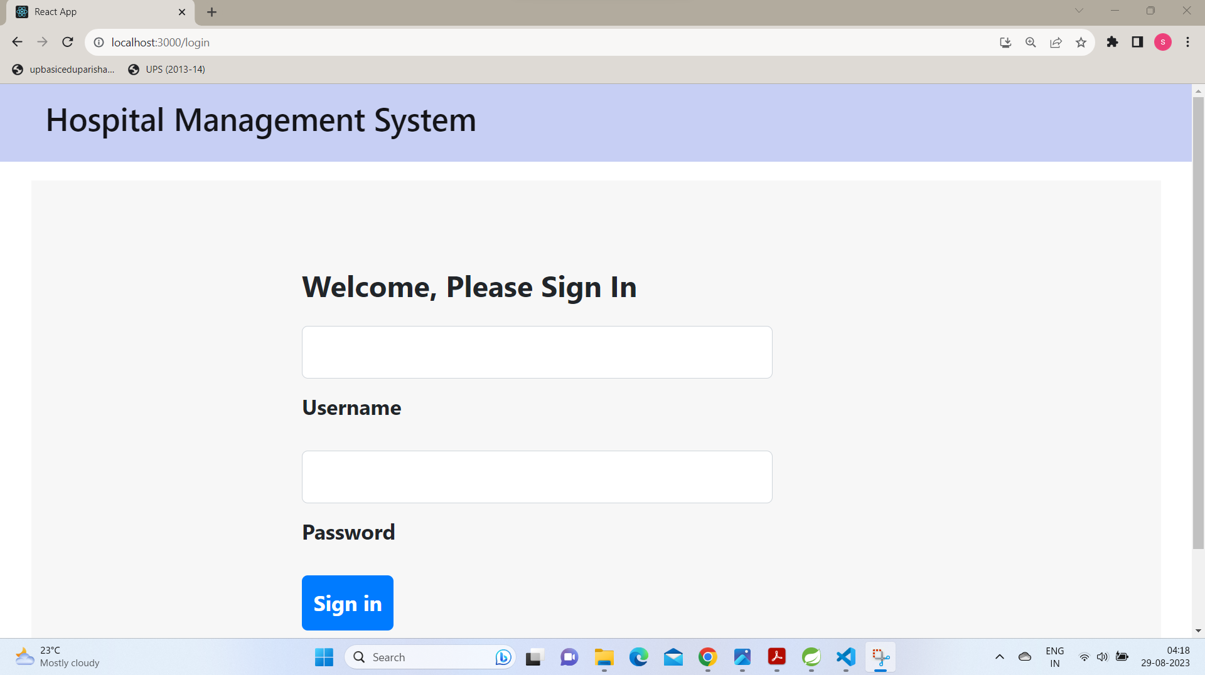
carehub
Homepage

Slide 12
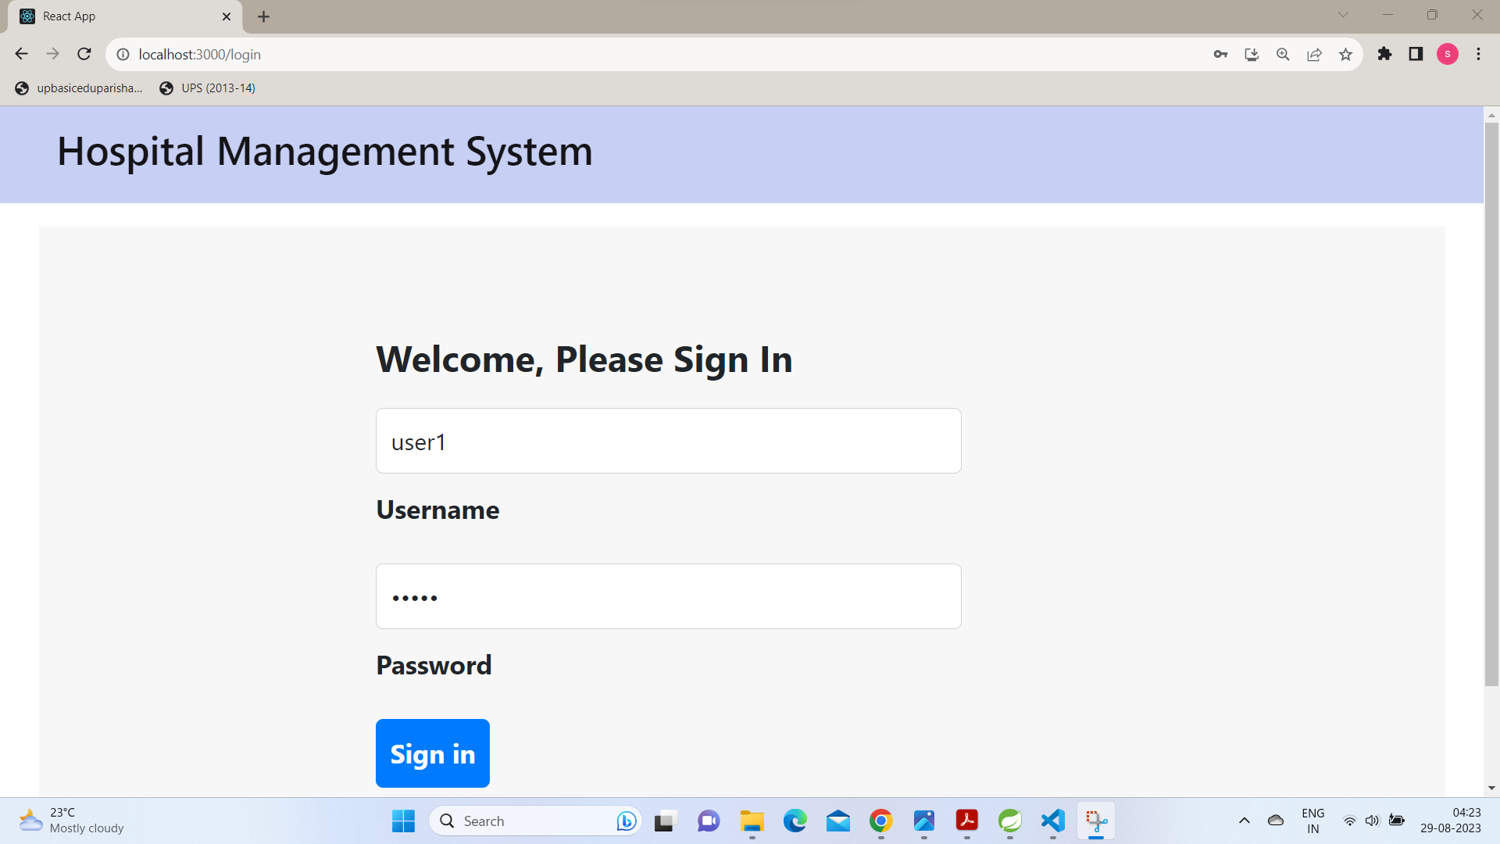
carehub
Homepage

Slide 13
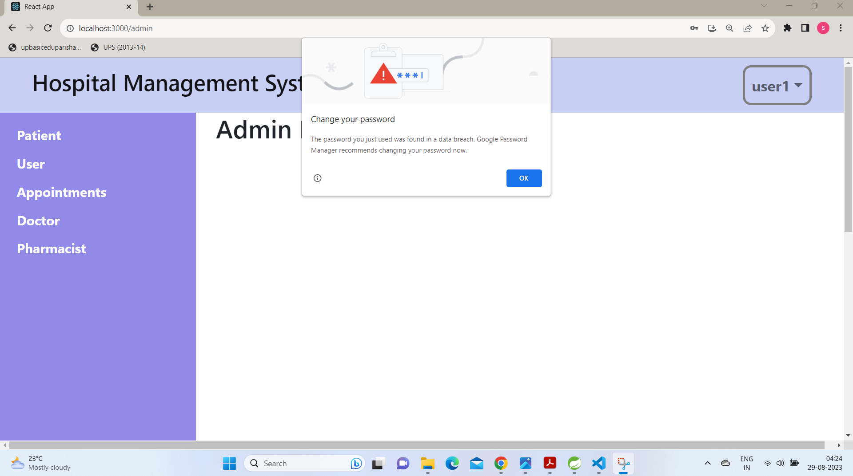
carehub
Admin Panel

Slide 14
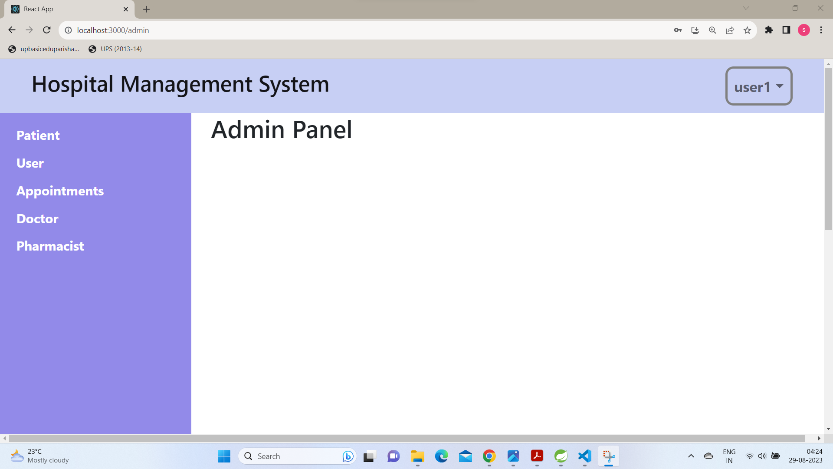
carehub
Admin Panel

Slide 15
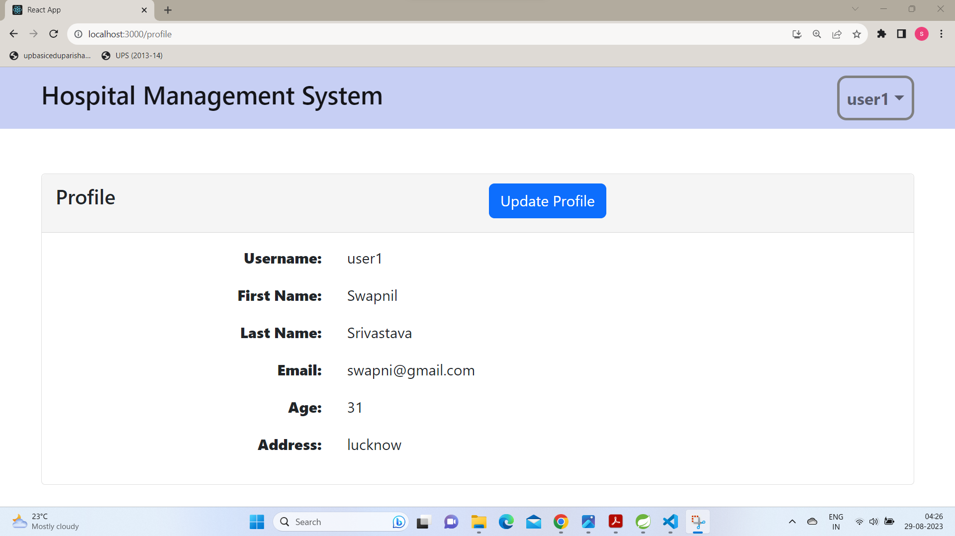
carehub
Admin profile :-

Slide 16
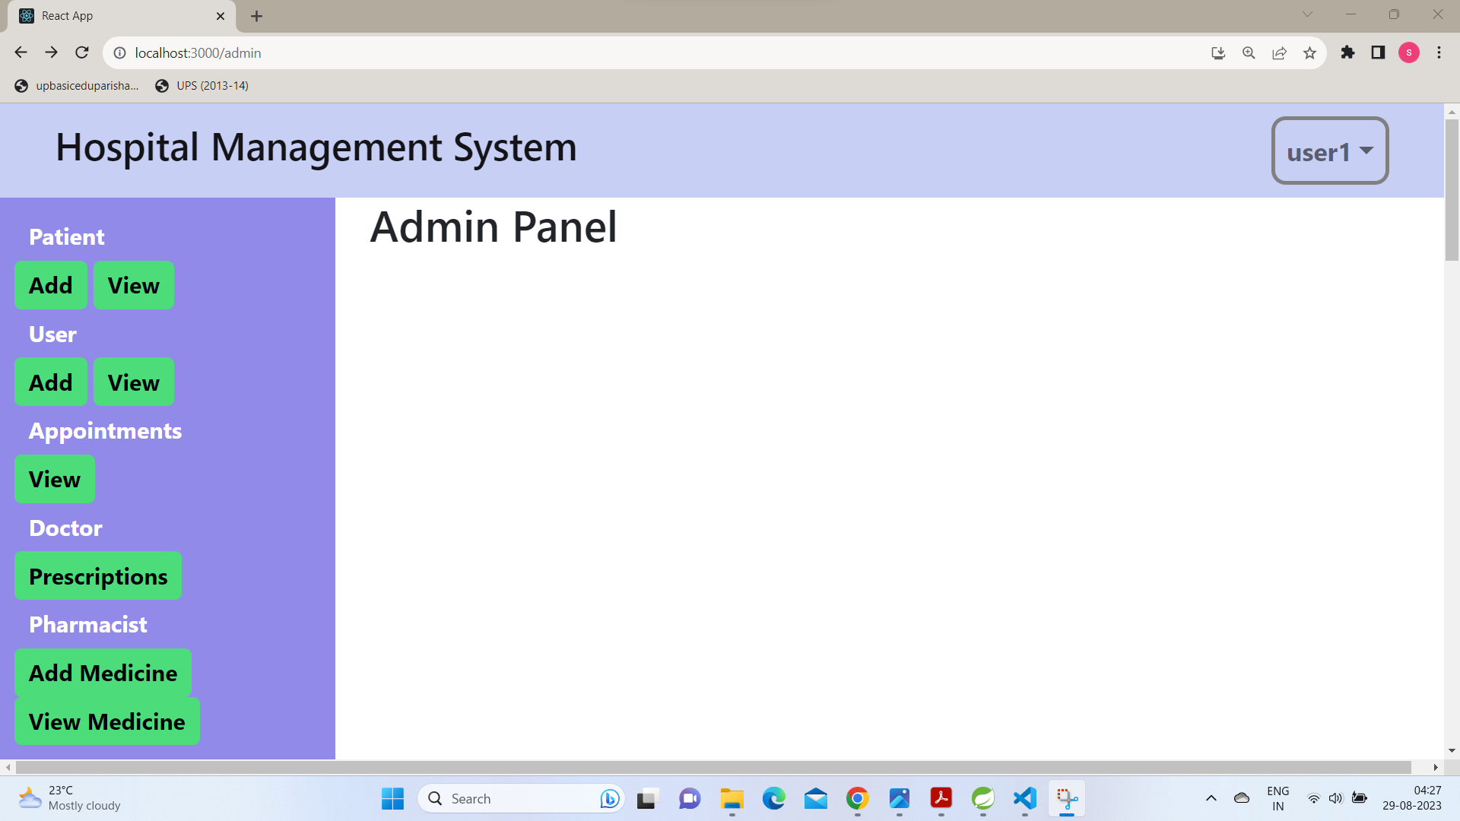
carehub
Admin Panel :-

Slide 17
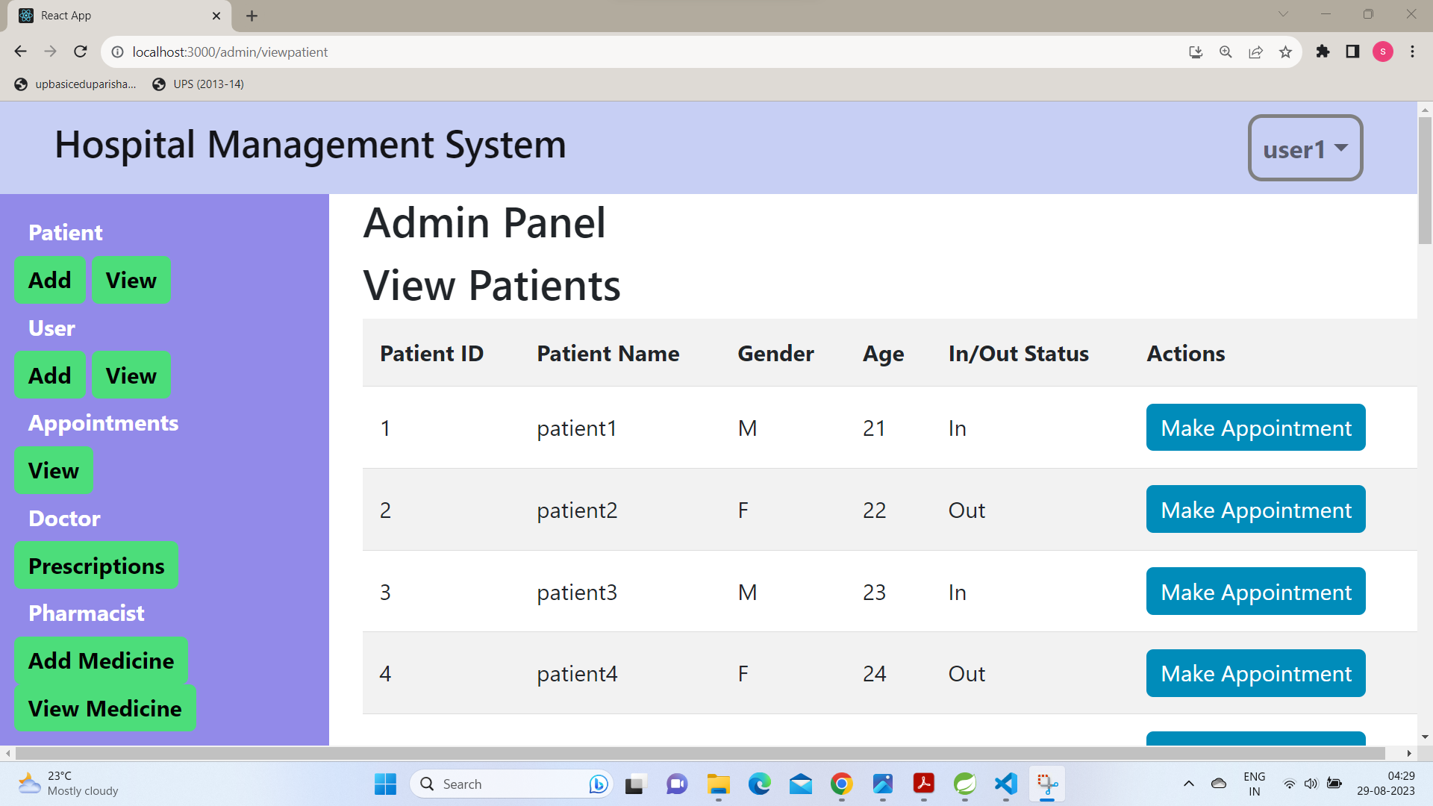
carehub
Admin Panel
(view Patient)

Slide 18
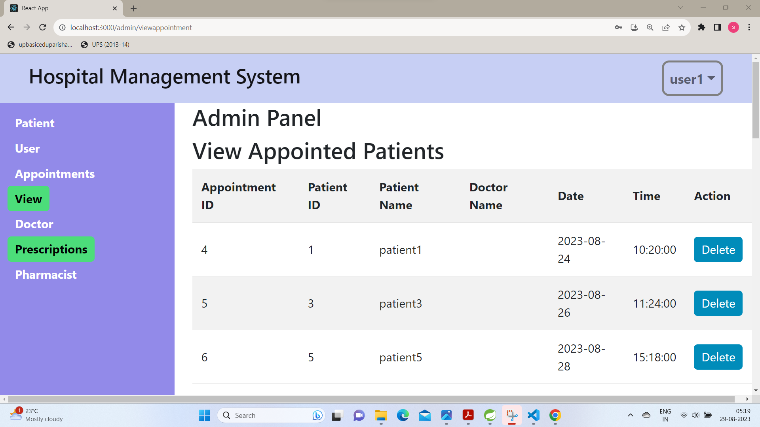
carehub
Admin Panel
(view Appointed
Patient)

Slide 19
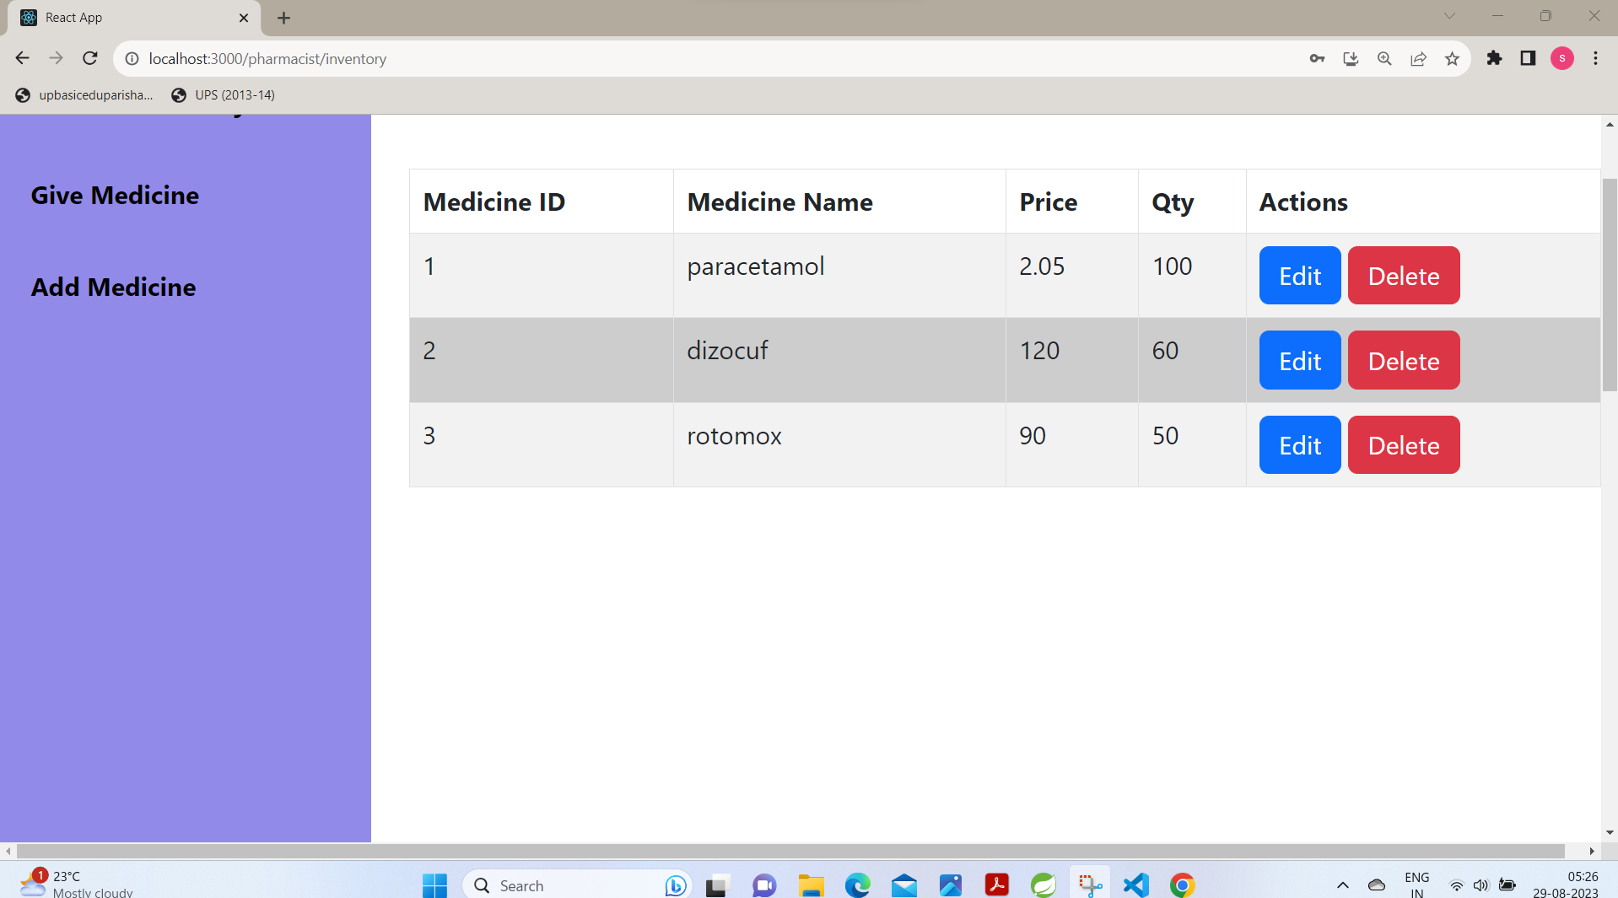
carehub
Pharmacist
Panel

Slide 20
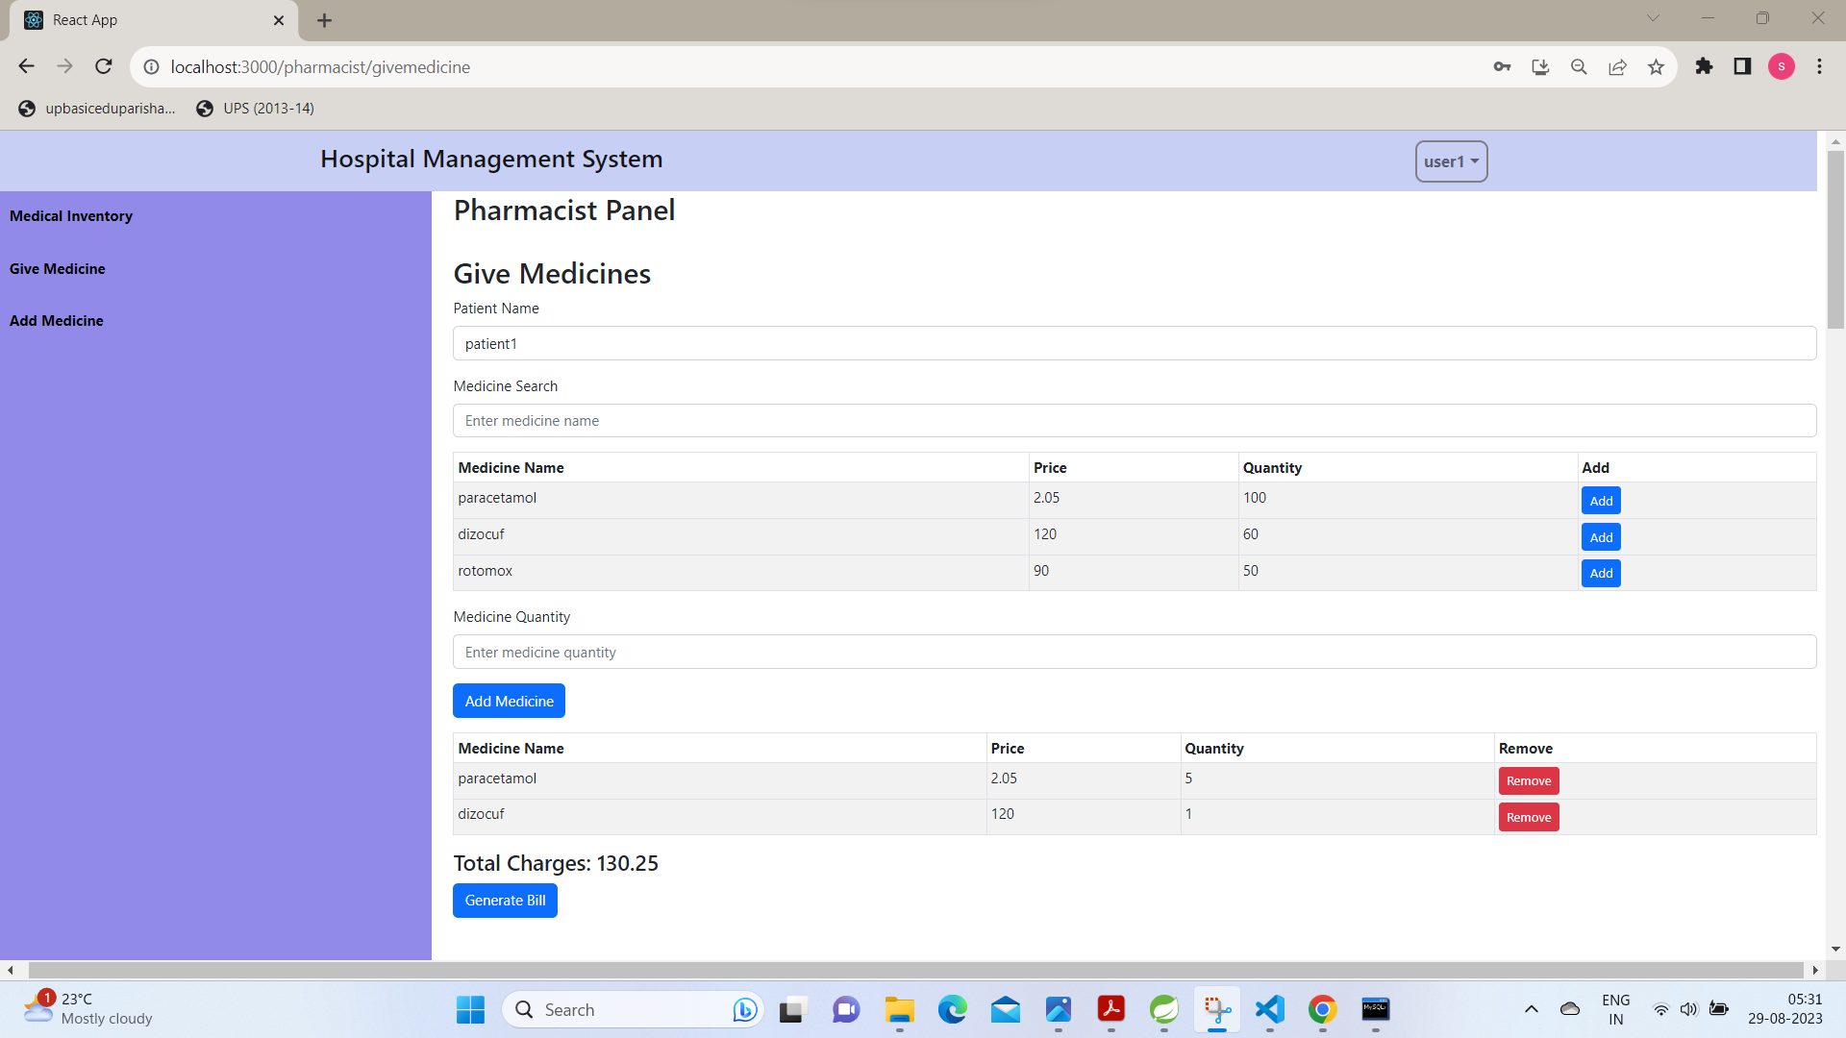
carehub
Pharmacist
Panel with
Billing

Slide 21
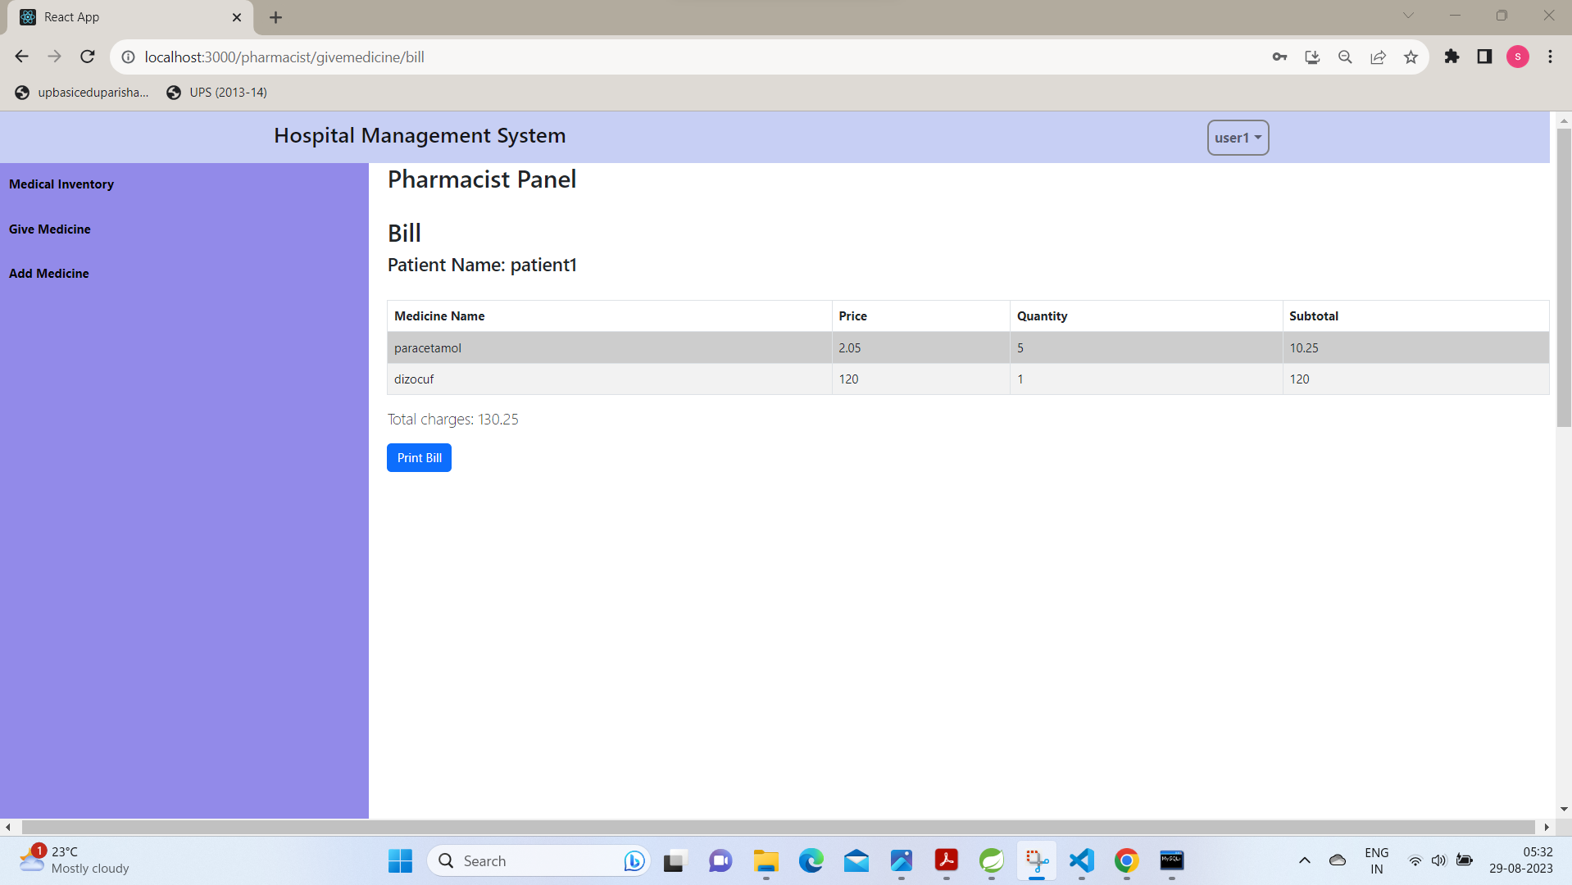
carehub
Pharmacist
Panel with
Billing

Slide 22
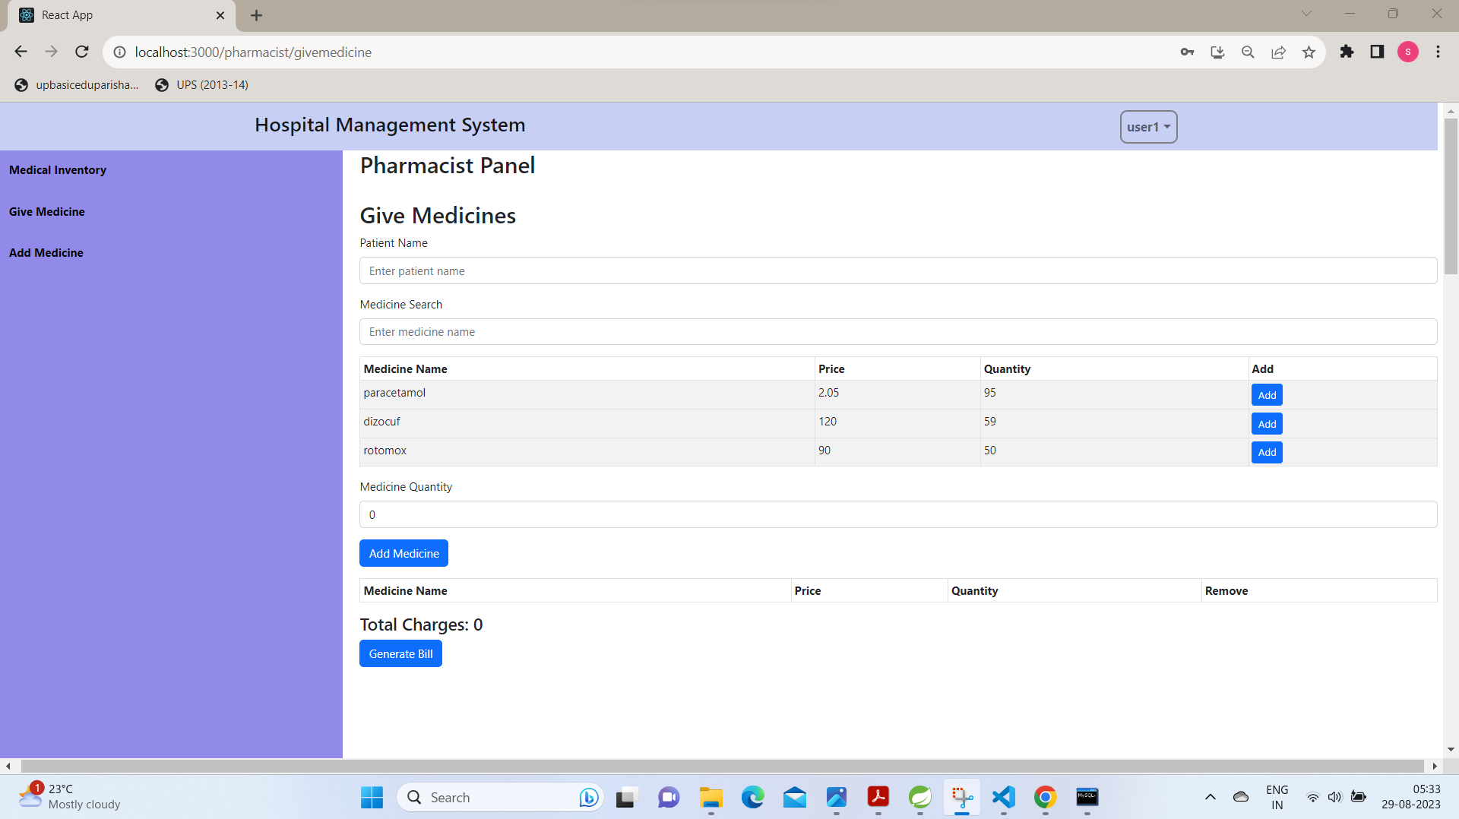
carehub
Updated
Pharmacist
Panel

Slide 23
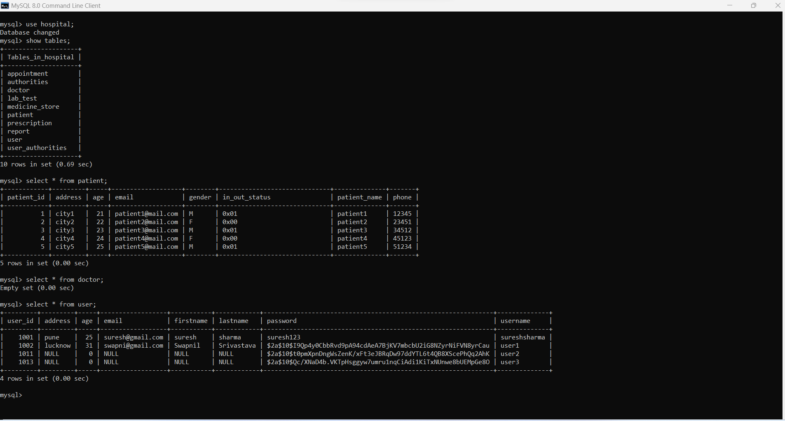
carehub
Database

Slide 24
carehub
Future Enhancements
Online Payment Method
Medicine delivery services to home
Automated Follow-Up Reminders via email, sms etc.
Patient Feedback and Surveys

Slide 25
carehub
Thank You

